Slide 1
Microsoft Power BI

Slide 2
Managing Power BI using the Power BI Admin APIs
Rick Xu
Senior Program Manager
Power BI Team
Ted Pattison
Principal Program Manager
Power BI Customer Advisory Team (PBICAT)

Slide 3
Welcome to Power BI Dev Camp
Power BI Dev Camp Portal - https://powerbidevcamp.net

Slide 4
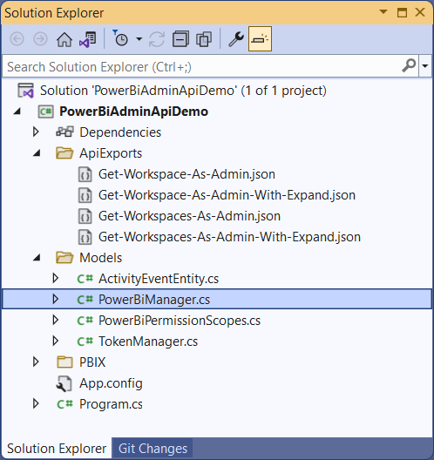
Try out the Sample Code used in this Webinar
You can download and try out the sample code used in this webinar
Implemented as C# console application which uses the Power BI .NET SDK
Download this code from https://github.com/PowerBiDevCamp/PowerBiAdminApiDemo

Slide 5
Agenda
Introduction to the Power BI Admin APIs
Discovering Workspaces and Artifacts
Enforcing Governance
Scanning Workspaces
Extracting Activity Events
Power BI Admin API Roadmap

Slide 6
Ways to Call the Power BI REST API
Call the Power BI REST API directly by executing HTTP operations
Open standards allow calling the Power BI API from any web development platform
Developers work directly with JSON to send request data and consume response data
Program with C# using the Power BI .NET SDK
Simple .NET wrapper on top of Power BI REST API to increase developer productivity
Hides low-level details of executing HTTP requests and converting data to/from JSON
C# code calling Power BI APIs can be used in console applications or in Azure functions
Develop PowerShell scripts which MicrosoftPowerBIMgmt cmdlet library
PowerShell makes it easy for Power BI administrators to modify and execute scripts
PowerShell scripts can be run from desktop computer, VM or Azure function
Call the Power BI REST API from Power Apps and Power Automate
See Dec 2021 session of Power BI Dev Camp for more info https://www.youtube.com/watch?v=oEZIbXB2-Js

Slide 7
Microsoft Documentation for Power BI REST API
Get familiar with Admin section of Power BI REST API documentation
https://docs.microsoft.com/en-us/rest/api/power-bi/admin/

Slide 8
Understanding User APIs versus Admin APIs
You can divide Power BI API operations into two categories
Power BI User APIs
Power BI Admin APIs
Power BI User APIs
User APIs require user to be member of target workspace(s)
User API cannot access workspaces in which the caller is not a member
User APIs can be called by users and by service principals
Example: GetGroups operation returns all workspaces in which caller is a member
Power BI Admin APIs
Admin APIs provide access to every workspace within current Power BI tenant
Example: GetGroupsAsAdmin operation returns all workspaces in tenant

Slide 9
Calling the Power BI Admin API as a User
Azure AD user account must be configured as Power BI Administrator
Global tenant admin are automatically in role of Power BI Administrator
Azure AD access token must contain specific delegated permissions
Tenant.Read.All provides caller with read-only access
Tenant.ReadWrite.All provides caller with read/write access
Token acquisition will fail if current user not in role of Power Bi Administrator

Slide 10
Calling the Power BI Admin API as Service Principal
You can call Power BI Admin APIs as Service principal
Current Admin API support for SP currently limited to read-only operations
Requires configuring tenant-level settings in Power BI Admin portal
Access token for service principal do not contain any permissions
Service principal access to Admin APIs controlled through tenant-level settings
Service principal access to User APIs controlled through workspace membership

Slide 11
Calling the Power BI Admin API using PowerShell
MicrosoftPowerBIMgmt library provides access to Power BI APIs using PowerShell
-Scope parameter allows caller to switch between User API and Admin API
Set –Scope parameter to Individual to call Power BI User API
Set –Scope parameter to Organization to call Power BI Admin API
Some but not all cmdlets in MicrosoftPowerBIMgmt support calling to Power BI Admin API

Slide 12
Get a List of All Active Workspaces within a Tenant
Each workspace has a type property
type=Workspace => workspace is a V2 app workspace
type=Group => workspace is a V1 app workspace
type=PersonalGroup => workspace is personal workspace

Slide 13
Developer Sample: PowerBiAdminApiDemo
A simple C# console application to demonstrate calling Power BI Admin API
Built using the Power BI .NET SDK
Source code can be viewed or downloaded from public GitHub repository
https://github.com/PowerBiDevCamp/PowerBiAdminApiDemo

Slide 14
Agenda
Introduction to the Power BI Admin APIs
Discovering Workspaces and Artifacts
Enforcing Governance
Scanning Workspaces
Extracting Activity Events
Power BI Admin API Roadmap

Slide 15
Calling GetGroupsAsAdmin
Call GetGroupsAsAdmin to inspect all workspaces in tenant
URL for Admin API call goes through admin endpoint
https://api.powerbi.com/v1.0/myorg/admin/groups?$top=100
Make use of the $filter parameters type and state
These two query string parameters have been optimized for performance
$filter=state eq 'Active' and type eq 'Workspace'
Call GetGroupsAsAdmin using Power BI .NET SDK

Slide 16
Inspecting GetGroupsAsAdmin Response in Fiddler

Slide 17
Calling GetGroupsAsAdmin with Expand Parameter
Expand parameter can be used to populate workspace collections
Expand options include users, reports, dashboards, datasets and dataflows

Slide 18
Managing Workspace Membership
Power BI Admin API cannot be used to create or manage workspace content
You must use Power BI User API to import PBIX files and manage datasets
Power BI Admin API provides the ability to add and delete workspace members
You can add your user account to any workspace as admin using Power BI Admin API
Once added as admin, you have total control over workspace using Power BI User API
Power BI Admin API operation to manage workspace members
GetGroupUsersAsAdmin
AddUserAsAdmin
DeleteUserAsAdmin

Slide 19
GetCapacitiesAsAdmin
Returns a list of all capacities in the current Power BI tenant
Result includes id, display name, sku, state, region and list of admins

Slide 20
GetCapacityUsersAsAdmin
Returns a list of all users for a specific capacity
capacityUserAccesRight indicates whether user has admin permissions or assign permissions

Slide 21
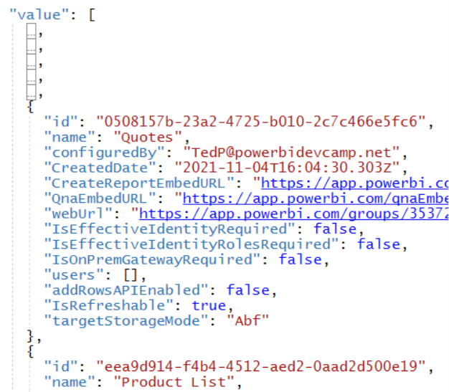
GetDatasetsInGroupAsAdmin
Get operation contains workspace ID in URL
https://api.powerbi.com/v1.0/myorg/admin/groups/{WorkspaceId}/datasets

Slide 22
GetDatasourcesAsAdmin
Allows you to discover all datasources for a specific dataset
JSON result contains datasource type, connection details, datasourceId and gatewayId

Slide 23
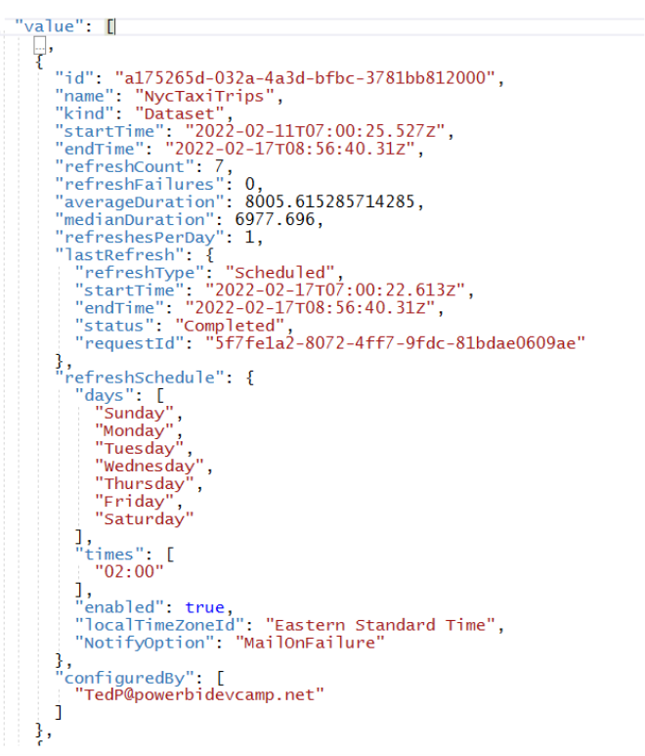
GetRefreshablesAsAdmin
Returns a list of all datasets and dataflows which support refresh
Results include start time, end time and status of last request
Results include scheduling configuration

Slide 24
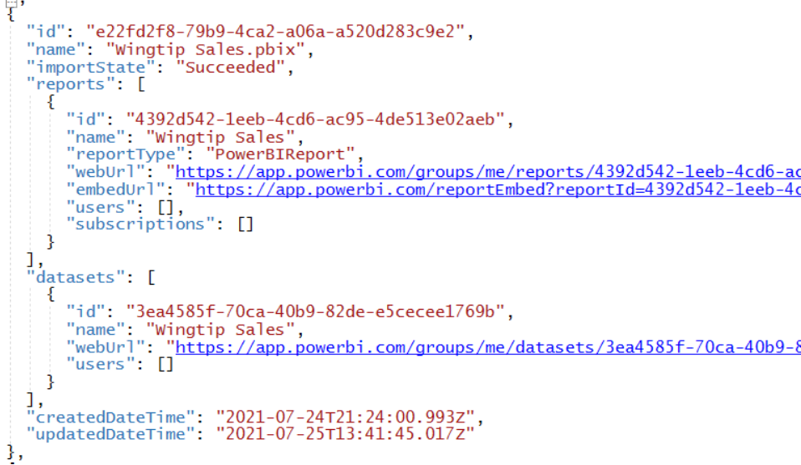
GetImportsAsAdmin
Tracks Power BI artifacts imported from PBIX, RDL & JSON files
PBIX files used to import datasets and/or reports
RDL files used to import paginated reports
JSON files used to import dataflows

Slide 25
More Power BI Admin API Discovery Operations
GetReportsAsAdmin
GetDashboardsAsAdmin
GetAppsAsAdmin

Slide 26
Agenda
Introduction to the Power BI Admin APIs
Discovering Workspaces and Artifacts
Enforcing Governance
Scanning Workspaces
Extracting Activity Events
Power BI Admin API Roadmap

Slide 27
Answering the question "Who has access to What?"
GetDatasetUsersAsAdmin
Who has access to a specific dataset?
GetReportUsersAsAdmin
Who has access to a specific report?
GetDashboardUsersAsAdmin
Who has access to a specific dashboard?
GetDataflowUsersAsAdmin
Who has access to a specific dataflow?
GetAppUsersAsAdmin
Who has access to a specific app?

Slide 28
GetReportUsersAsAdmin Example

Slide 29
Understanding Continuation Tokens
Some Admin API operation have potential to return significant volume of data
Admin API operations might need to return volume of data too large for single HTTP request
Continuation tokens used to return large volumes of data over series of HTTP requests
How do you call Admin API operation that returns continuation tokens?
First call is made without passing continuation token
Any call that returns with a continuation token indicates there's more data
After first call, all subsequent calls must pass continuation token from previous response
The final call returns with no continuation token indicating that all data has been retrieved
Admin API operations that return continuation tokens
GetUserArtifactAccessAsAdmin
GetUserSubscriptionsAsAdmin
GetUnusedArtifactsAsAdmin
GetActivityEvents

Slide 30
GetUserArtifactAccessAsAdmin
Used to discover which artifacts can be accessed by a specific user
UserId can be UPN (bob@acmecorp.com) or GUID for Azure AD user account (aka GraphId)
First Call
Did Call return token?
Subsequent Calls

Slide 31
GetUserArtifactAccessAsAdmin Results
Results from multiple calls must be appended together
create collection variable
append results
append results

Slide 32
GetUserSubscriptionsAsAdmin

Slide 33
GetUnusedArtifactsAsAdmin
Returns list of artifacts in workspace not accessed in last 30 days
Each call must target a single workspace

Slide 34
Discover Widely Shared Artifacts
Find reports which have been shared to entire organization
https://api.powerbi.com/v1.0/myorg/admin/widelySharedArtifacts/linksSharedToWholeOrganization
Find reports which have been exposed to public Internet using Publish to Web
https://api.powerbi.com/v1.0/myorg/admin/widelySharedArtifacts/publishedToWeb

Slide 35
Agenda
Introduction to the Power BI Admin APIs
Discovering Workspaces and Artifacts
Enforcing Governance
Scanning Workspaces
Extracting Activity Events
Power BI Admin API Roadmap

Slide 36
Guidance for Calling GetGroupsAsAdmin
Optimize calls to GetGroupsAsAdmin
Make use of the $filter parameters type and state
Be mindful of the extra data returned when using the $expand filter
Understand limitations for calling GetGroupsAsAdmin
GetGroupsAsAdmin API calls limited to 50 calls/hour/tenant
Calls to GetGroupsAsAdmin taking more than 30 seconds will be terminated
Workspace Scanner API provides more scalable alternative to GetGroupsAsAdmin
Asynchronous, non-blocking API design avoids limitations of GetGroupsAsAdmin

Slide 37
Workspace Scan API Based on Three API Operations
PostWorkspaceInfo
Start asynchronous job to scan one or more workspaces
GetScanStatus
Check on the status of a workspace scan job
GetScanResult
Consume the results of completed workspace scan job

Slide 38
Scan Workspace API Called using Asynchronous Pattern
Custom Application
Power BI REST API
PostWorkspaceInfo - https://api.powerbi.com/v1.0/myorg/admin/workspaces/getInfo?datasourceDetails=true
async scan workspace job started
GetScanStatus - https://api.powerbi.com/v1.0/myorg/admin/workspaces/scanStatus/{ScanId}
async
scan workspace job completed
GetScanStatus - https://api.powerbi.com/v1.0/myorg/admin/workspaces/scanStatus/{ScanId}
workspace
info
workspace info
GetScanResult - https://api.powerbi.com/v1.0/myorg/admin/workspaces/scanResult/{ScanId}

Slide 39
Scanning Workspaces using PostWorkspaceInfo
get ID for workspace(s)
start workspace scan
loop until scan completes
Process scan results
Handle scan failure

Slide 40
Workspace Scan Results
Scan Results always include four collections with workspace artifacts

Slide 41
Scanning Workspace with Get Users
You can add getArtifactUsers parameter to get information on user permissions
workspace members
artifact users

Slide 42
Scanning Workspace with Lineage
Include lineage to add dashboard tiles, datasource references and upstream dataflows
tiles
datasource reference
datasource reference
upsreamDataflow

Slide 43
Scanning Workspace with Datasource Details
datasourceDetails parameters add datasourceInstances collection as top-level node
datasources

Slide 44
Scanning Workspaces with Dataset Schema
datasetSchema parameters adds schema information for tables and fields
table schema

Slide 45
Scanning for Dataset Expressions
datasetExpression parameters adds expressions for DAX and M code
DAX expression for measure
M code for query behind table

Slide 46
Agenda
Introduction to the Power BI Admin APIs
Discovering Workspaces and Artifacts
Enforcing Governance
Scanning Workspaces
Extracting Activity Events
Power BI Admin API Roadmap

Slide 47
GetActivityEvents
Endpoint for GetActivityEvents is GET operation
https://api.powerbi.com/v1.0/myorg/admin/activityevents
200 requests/hour
Time window cannot exceed 24-hour UTC time period
Query String Parameters
startDateTime (e.g. '2022-01-27T00:00:00' )
endDateTime (e.g. '2022-01-27T23:59:59’ )
$filter (e.g. Activity eq 'ViewReport')
continuationToken

Slide 48
GetActivityEvents

Slide 49
Agenda
Introduction to the Power BI Admin APIs
Discovering Workspaces and Artifacts
Enforcing Governance
Scanning Workspaces
Extracting Activity Events
Power BI Admin API Roadmap

Slide 50
Power BI Admin API Roadmap
What do we have planned moving forward from February 2022?

Slide 51
Summary
Introduction to the Power BI Admin APIs
Discovering Workspaces and Artifacts
Enforcing Governance
Scanning Workspaces
Extracting Activity Events
Power BI Admin API Roadmap

Slide 52
Microsoft Power BI
Questions?

